Slide 1
Modeling VNFs in a contrail environment
How to design a VNF using Contrail & Heat
Umberto Manferdini

Slide 2
Where are we now?
What’s Heat?
Contrail and Heat: modeling VNFs
From vanilla Neutron to Juniper Contrail
Service Chaining

Slide 3


Juniper contrail
Juniper SDN Controller
Manages virtual networking within the DC
Based on well known protocols and solutions like BGP and VPNs

Slide 4






Originally it was a switched network

Slide 5

Then data centers came

Slide 6


Finally virtualization appeared
A network within a network
A network inside a server
Virtual Machines are the new appliances
Virtual Networks are the new switched networks

Slide 7


Same thing…different objects
physical switch/router
virtual router

Slide 8

Call for new models
Yesterday, we used cables to connect physical devices
Now, we have to connect virtual machines
We need new models to describe these new scenarios

Slide 9


Virtualization brings automation
Virtualization is software
Software is more inclined to be automated
Virtualization opens to network automation

Slide 10


Automation means heat
Openstack deploys and manage the DC
Openstack has tool for automation called Heat
Contrail fully integrates with Heat
Contrail provides its own Heat objects

Slide 11


And heat means yaml
Heat is a built-in Openstack module
Heat uses YAML language
Easy to read and write

Slide 12
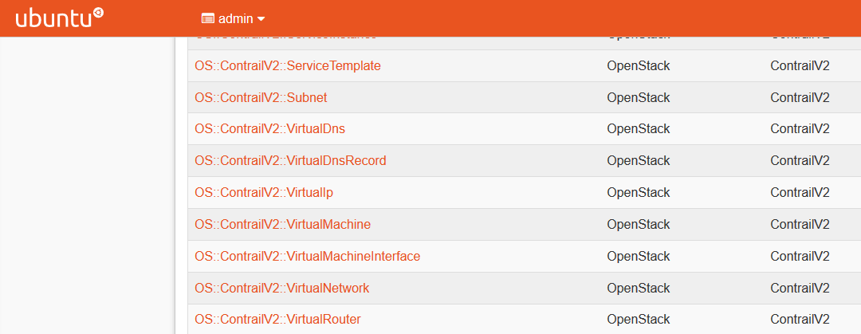
Contrail has its own objects

Slide 13

Automation through stacks
Heat creates stacks
Stacks are a list resources
Resources are virtual network, virtual machines, etc…

Slide 14

What do I have to do?
New Virtual Machine on a Virtual Network
New Virtual Network
Manage VLANS in a “v” environment
Extend Virtual Network outside the DC

Slide 15
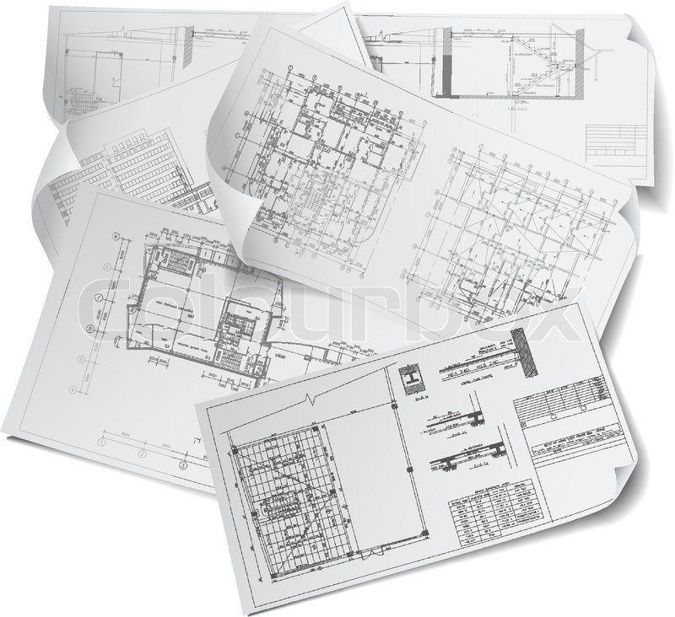
From words to heat
Need to take an abstract input as request
For example “configure a virtual network”
And translate it into a Heat template

Slide 16


What’s a heat template?
Structured YAML files
Template file, where we define resources
Environment file, where we assign values to parameters

Slide 17
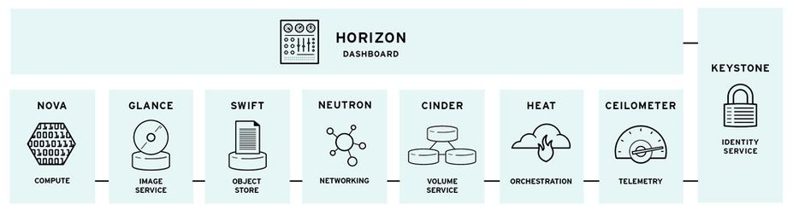
Objects for everyone
Openstack offers a wide range of Heat object
Nova objects
Glance objects
Contrail objects
…

Slide 18
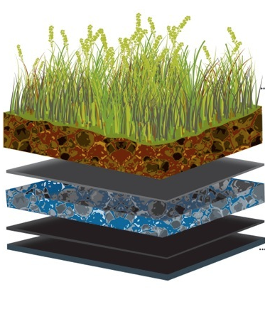
Inside a heat template
Heat templates made of multiple sections
Two main sections
Parameters section
Resource section

Slide 19



Declaring parameters
heat_template_version: 2015-04-30
parameters:
myname :
type: string
default: ‘nameX’
myimage :
type: string
default: ‘ubuntu’
myflavor :
type: string
default: ‘smallvm’

Slide 20
Declaring resources
resources:
test-net:
type: OS::Neutron::Net
properties:
name: ‘heat-net’
test-subnet:
type: OS::Neutron::Subnet
properties:
name: ‘heat-subnet’
network_id: { get_resource: test-net }
cidr: ‘192.168.1.0/16’
server1:
type: OS::Nova::Server
properties:
name: { get_param: myname }
image: { get_param: myimage }
flavor: { get_param: myflavor }
networks:
- network: { get_resource: test-net }
resource type
hardocded value
get_resource
get_param

Slide 21

Environment file
Parameters defined in the template file
We need to give them a value
Environment file is for this!
parameters:
myname : Ubuntu-1
myimg : ubu14-iso
myflavor : linux-perf

Slide 22

Who’s first?
Heat is smart
But not too smart
Some order is required
Use “depends_on” to manage it
server1:
type: OS::Nova::Server
depends_on [test-subnet, test-net]
properties:
name: { get_param: myname }
image: { get_param: myimage }
flavor: { get_param: myflavor }
networks:
- network: { get_resource: test-net }

Slide 23

Virtual network
Virtual machine interface
Instance IP
BGPaaS
Sub-interfaces
Allowed address pair

Slide 24
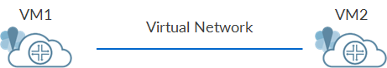
Contrail virtual networks
Key element in Contrail networking
Used to connect Virtual Machines

Slide 25

Virtual network properties
Virtual Networks has a name
Reference an IPAM (Contrail wrapper for virtual networks)
resources:
vip_vn:
type: OS::ContrailV2::VirtualNetwork
properties:
name: ‘myvn’
network_ipam_refs: ['default-domain:default-project:default-network-ipam']

Slide 26
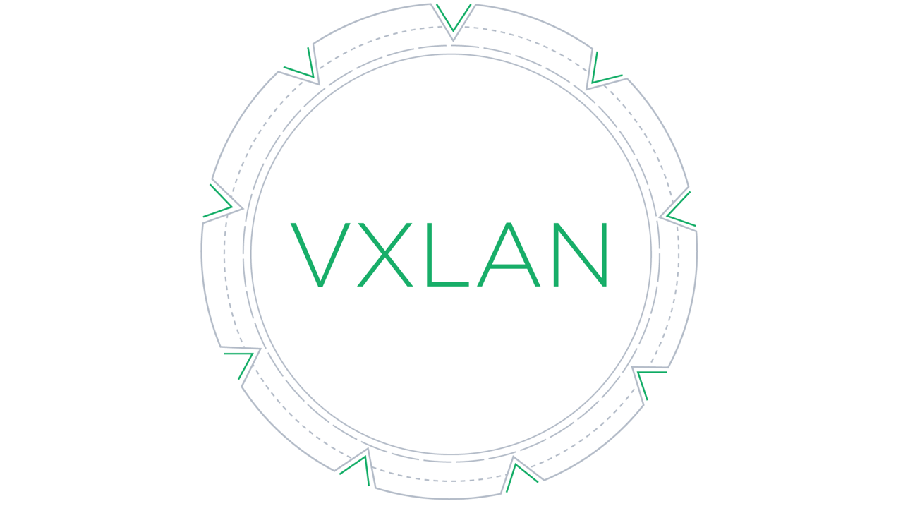

Customizing the virtual network
Forwarding mode
RPF check
Flooding unknown unicast
VXLAN identifier
resources:
vip_vn:
type: OS::ContrailV2::VirtualNetwork
properties:
virtual_network_properties:
{
virtual_network_properties_forwarding_mode: ‘l3’,
virtual_network_properties_rpf: ‘enable’,
virtual_network_properties_vxlan_network_identifier: ‘1234’,
}
flood_unknown_unicast: ‘true’

Slide 27

How do I ecmp?
Contrail supports ECMP
Up to 5 configurable fields
resources:
vip_vn:
type: OS::ContrailV2::VirtualNetwork
properties:
ecmp_hashing_include_fields:
{
ecmp_hashing_include_fields_destination_ip: ‘true’,
ecmp_hashing_include_fields_destination_port: ‘false’,
ecmp_hashing_include_fields_hashing_configured: ‘true’,
ecmp_hashing_include_fields_ip_protocol: ‘true’,
ecmp_hashing_include_fields_source_ip: ‘false’,
ecmp_hashing_include_fields_source_port: ‘false’,
}
port_security_enabled: ‘true’

Slide 28

Creating subnets
Not a dedicated object
Network address and mask
Allocation pools
DHCP
Gateway
Allocation order

Slide 29
Subnets in heat
resources:
vip_vn:
type: OS::ContrailV2::VirtualNetwork
properties:
network_ipam_refs_data:
[{
network_ipam_refs_data_ipam_subnets:
[{
network_ipam_refs_data_ipam_subnets_subnet:
{
network_ipam_refs_data_ipam_subnets_subnet_ip_prefix: '192.168.33.0',
network_ipam_refs_data_ipam_subnets_subnet_ip_prefix_len: '24',
},
network_ipam_refs_data_ipam_subnets_addr_from_start: 'true',
network_ipam_refs_data_ipam_subnets_default_gateway: '192.168.33.3',
network_ipam_refs_data_ipam_subnets_enable_dhcp: 'false',
network_ipam_refs_data_ipam_subnets_allocation_pools:
[{
network_ipam_refs_data_ipam_subnets_allocation_pools_start: '192.168.33.5',
network_ipam_refs_data_ipam_subnets_allocation_pools_end: '192.168.33.10',
}]
}]
}]

Slide 30
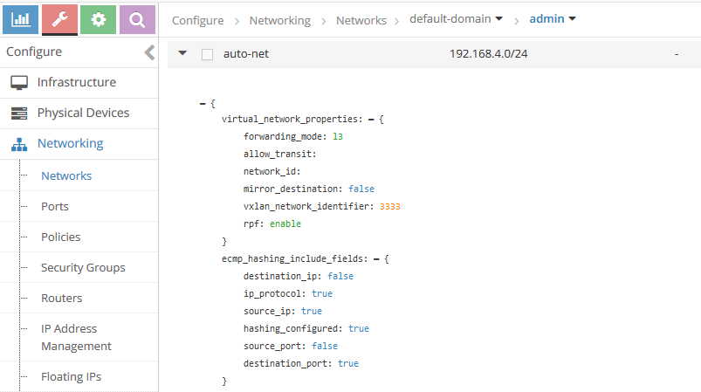
Checking everything is alright

Slide 31
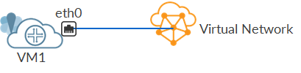
Virtual nic
Virtual machine port
Connects VM to the Virtual Network
It is actually 2 objects
Virtual Machine Interface
Instance IP

Slide 32
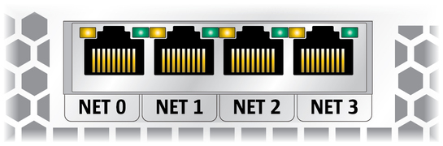
Virtual machine interface
Minimal configuration
Name
Virtual Network Reference
resources:
vmi_newnet:
type: OS::ContrailV2::VirtualMachineInterface
properties:
name: 'my_vmi'
virtual_network_refs: [{ list_join: [':', { get_attr: [ newnet_vn, fq_name ] } ] }]
Internal function
Fully Qualified Name
prepends “domain:project”

Slide 33

Leveraging existing networks
Existing network
Simply pass the FQDN network name as a parameter
FQDN name means “domain:project:network”
vmi_prex:
type: OS::ContrailV2::VirtualMachineInterface
properties:
virtual_network_refs: [ {get_param: mgmt-net} ]
env
file
parameters:
mgmt-net: 'default-domain:admin:mgmt'

Slide 34
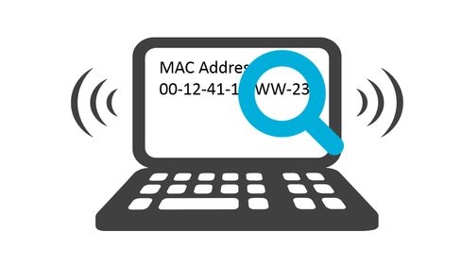
I want my own mac
By default, Contrail automatically assigns a MAC to a port
Optionally, we can assign a custom MAC
resources:
vmi_newnet:
type: OS::ContrailV2::VirtualMachineInterface
properties:
virtual_machine_interface_mac_addresses:
{
virtual_machine_interface_mac_addresses_mac_address: [ ‘aa:bb:cc:dd:ee:ff’],
}

Slide 35
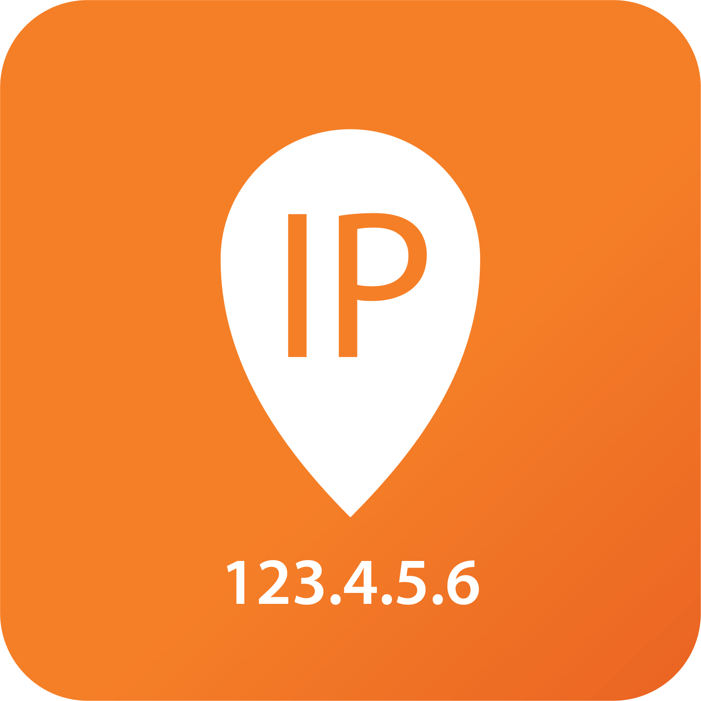
A port needs an ip
Second element is the Instance IP
References a virtual networks
References a VMI
instanceip_1:
type: OS::ContrailV2::InstanceIp
depends_on: [ vmi_newnet, newnet_vn ]
properties:
virtual_machine_interface_refs: [{ get_resource: vmi_newnet }]
virtual_network_refs: [{ list_join: [':', { get_attr: [ newnet_vn, fq_name ] } ] }]

Slide 36

My ip or your ip?
We can reference an existing virtual network
Or specify a fixed IP address
iip_fixed:
type: OS::ContrailV2::InstanceIp
depends_on: [ vmi_obj ]
properties:
virtual_machine_interface_refs: [{ get_resource: vmi_obj }]
virtual_network_refs: [{ get_param: mgmt-net }]
instance_ip_address: ‘192.168.1.4’

Slide 37
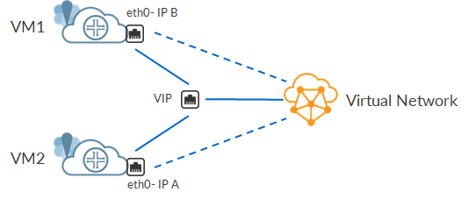
Vip address
Many VMs sharing an IP
To spread the load on multiple devices
Leveraging Contrail ECMP capabilities

Slide 38


Allowing multiple addresses on a port
NO
192.168.1.13
192.168.1.14
192.168.1.14
192.168.1.14
YES

Slide 39
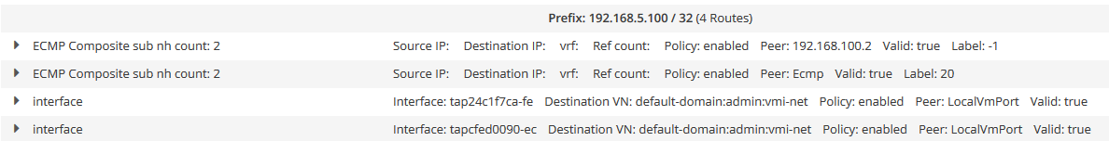
Vip means ecmp
VIP configured on the VMI
Need to allow an Allowed Address Pair
Routes automatically added in Contrail
Multiple routes towards the same VIP are seen as ECMP paths

Slide 40

Allowed address pair
resources:
vmi_1:
type: OS::ContrailV2::VirtualMachineInterface
properties:
name: 'my_vmi'
virtual_network_refs: [{ list_join: [':', { get_attr: [ new_vn, fq_name ] } ] }]
virtual_machine_interface_mac_addresses:
{
virtual_machine_interface_mac_addresses_mac_address: ‘aa:bb:cc:dd:ee:ff’,
}
virtual_machine_interface_allowed_address_pairs:
{
virtual_machine_interface_allowed_address_pairs_allowed_address_pair: [{
virtual_machine_interface_allowed_address_pairs_allowed_address_pair_ip:
{
virtual_machine_interface_allowed_address_pairs_allowed_address_pair_ip_ip_prefix: '192.168.1.100’,
virtual_machine_interface_allowed_address_pairs_allowed_address_pair_ip_ip_prefix_len: '32',
},
virtual_machine_interface_allowed_address_pairs_allowed_address_pair_mac: ‘aa:bb:cc:dd:ee:ff’,
virtual_machine_interface_allowed_address_pairs_allowed_address_pair_address_mode: 'active-active',
}]
}

Slide 41


Multiple ips on the same mac
Configuration within the VMI object
Add allowed pairs
MAC address
IP address
AAP 1
MAC Y
IP B
VM vNIC
IP X
MAC Y
AAP 2
MAC Y
IP D

Slide 42

Contrail picks the mac
We can avoid to define a custom MAC
Just remove MAC definition and AAP MAC reference
resources:
vmi_1:
type: OS::ContrailV2::VirtualMachineInterface
properties:
name: 'my_vmi'
virtual_network_refs: [{ list_join: [':', { get_attr: [ new_vn, fq_name ] } ] }]
virtual_machine_interface_allowed_address_pairs:
{
virtual_machine_interface_allowed_address_pairs_allowed_address_pair: [{
virtual_machine_interface_allowed_address_pairs_allowed_address_pair_ip:
{
virtual_machine_interface_allowed_address_pairs_allowed_address_pair_ip_ip_prefix: { get_param: '192.168.1.100' },
virtual_machine_interface_allowed_address_pairs_allowed_address_pair_ip_ip_prefix_len: { get_param: '32' },
},
virtual_machine_interface_allowed_address_pairs_allowed_address_pair_address_mode: { get_param: 'active-active' },
}]
}

Slide 43
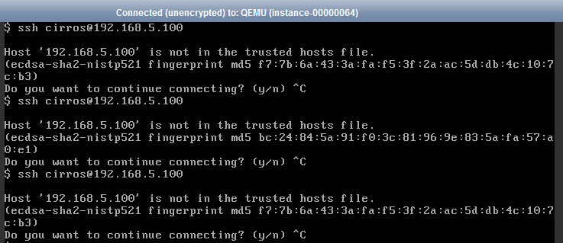
Vip in action

Slide 44
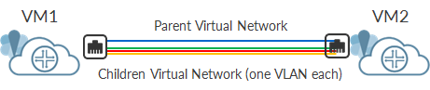
Trunk ports
Multiple vlans inside the VM
Virtual NIC must become a Trunk
Do not Use Openstack Trunk Object
Use Contrail sub-interfaces (which came earlier!)

Slide 45
How do trunks work?
Concept is easy
Create a parent network
Attach a VMI to it
Create child virtual networks, one for each vlan
Create child VMIs, one for each vlans
Child VMIs must reference the parent VMI
Child VMIs must use parent VMI MAC address
parent VMI
MAC
child
VMI
child
VMI
parent VN
child VN
vlan 100
child VN
vlan 200

Slide 46

First there is a father
resources:
parent_vn:
type: OS::ContrailV2::VirtualNetwork
properties:
name: { get_param: parent }
network_ipam_refs: ['default-domain:my-project:default-ipam']
network_ipam_refs_data:
[{
network_ipam_refs_data_ipam_subnets:
[{
network_ipam_refs_data_ipam_subnets_subnet:
{
network_ipam_refs_data_ipam_subnets_subnet_ip_prefix: '172.30.1.0',
network_ipam_refs_data_ipam_subnets_subnet_ip_prefix_len: '24',
},
}]
}]
vm_1:
type: OS::Nova::Server
properties:
name: 'trunk_vm'
image: 'vsrx'
flavor: 'vsrx'
networks:
- network: { get_resource: parent_vn }
parent VMI

Slide 47

Then the children
Child VN is a standard VN
No vlan defined here
No link to parent
child_vn_1:
type: OS::ContrailV2::VirtualNetwork
properties:
name: 'child1'
network_ipam_refs: ['default-domain:my-project:default-ipam']
network_ipam_refs_data:
[{
network_ipam_refs_data_ipam_subnets:
[{
network_ipam_refs_data_ipam_subnets_subnet:
{
network_ipam_refs_data_ipam_subnets_subnet_ip_prefix: '172.30.100.0',
network_ipam_refs_data_ipam_subnets_subnet_ip_prefix_len: '24',
},
}]
}]

Slide 48

Multiple ports, one mac
Child VMI is where the magic happens
We reference another VMI, the parent
We set the MAC to parent MAC VMI address
We assign the vlan
vmi_1:
type: OS::ContrailV2::VirtualMachineInterface
properties:
name: 'vmi_1'
virtual_network_refs: [{ get_resource: child_vn_1 }]
virtual_machine_interface_properties:
{
virtual_machine_interface_properties_sub_interface_vlan_tag: '100',
}
virtual_machine_interface_mac_addresses:
{
virtual_machine_interface_mac_addresses_mac_address: [{ get_attr: [vm_1, addresses, get_param: 'parent', 0, "OS-EXT-IPS-MAC:mac_addr"] }],
}
virtual_machine_interface_refs: [{ get_attr: [vm_1, addresses, get_param: 'parent', 0, "port"] }]

Slide 49

How do I get the right mac?
We need to obtain the MAC of the parent
By checking VM attributes
We extract it from ports attributes
Only check on the port connected to the parent network
virtual_machine_interface_mac_addresses:
{
virtual_machine_interface_mac_addresses_mac_address: [{ get_attr: [vm_1, addresses, get_param: 'parent', 0, "OS-EXT-IPS-MAC:mac_addr"] }],
}

Slide 50

Same old instance ip
Still need the Instance IP
But nothing new here
Same old Instance IP object
iip_1:
type: OS::ContrailV2::InstanceIp
depends_on: [ vmi_1 ]
properties:
virtual_network_refs: [{ get_resource: child_vn_1 }]
virtual_machine_interface_refs: [{ get_resource: vmi_1 }]

Slide 51
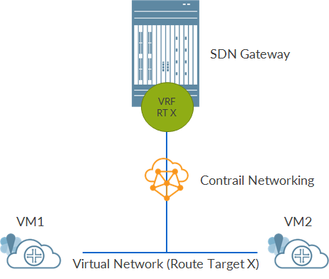
Going out the dc
My Virtual Network needs to leave the DC
In Openstack we have Provider Networks
Here still tenant networks
But we use Route targets
Then same old MP-BGP VPN mechanisms between Contrail and SDN gateway

Slide 52

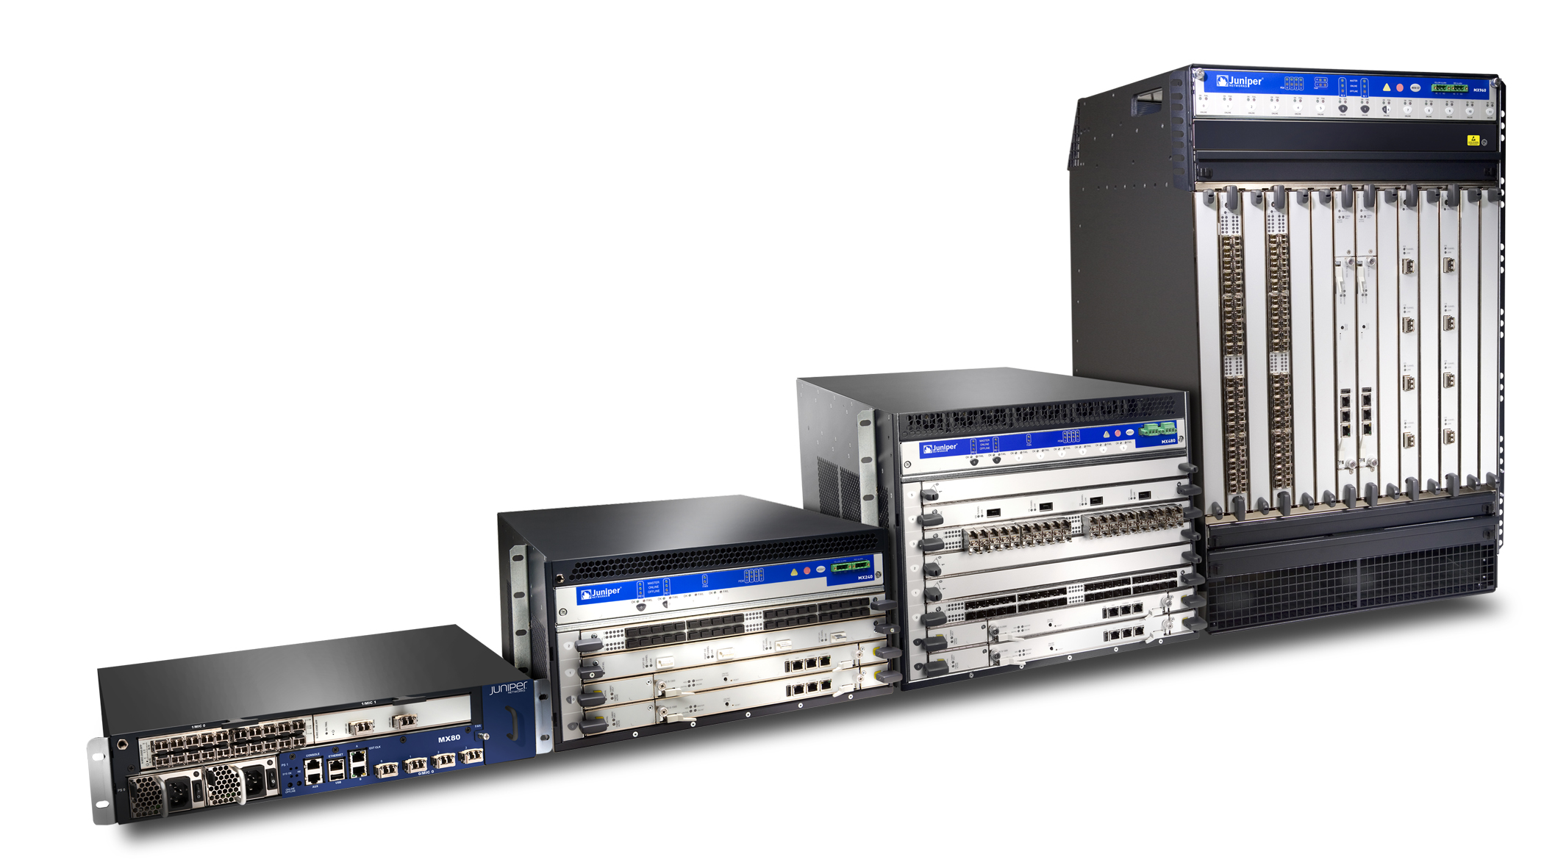
Sdn gateway as a pe
Need configuration on SDN gateway as well
We need a VRF
Matching route-target
Usual VRF import/export policies
root@sdn-gw# show routing-instances test_vn
instance-type vrf;
interface lo0.1000;
route-distinguisher 192.168.100.1:1;
vrf-import test_imp;
vrf-export test_exp;
vrf-table-label;

Slide 53

The right target
Virtual Network can have its own route target
Can import other route-targets
Can export route-targets
resources:
vip_vn:
type: OS::ContrailV2::VirtualNetwork
properties:
name: { get_param: name}
import_route_target_list:
{
import_route_target_list_route_target: [ 'target:65500:131' , 'target:65500:241' ]
}
export_route_target_list:
{
export_route_target_list_route_target: [ 'target:65500:201' ]
}
route_target_list:
{
route_target_list_route_target: ['target:65500:101'],
}

Slide 54
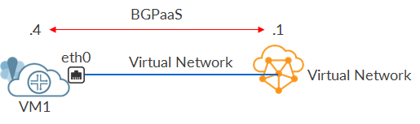
Bgp as a service
Totally new feature
VMs by default are blind to vRouter networking information
Need to create a communication between vRouter and the VM
This is BGP as a Service (BGPaaS)

Slide 55
Do you talk bgp?
VM must talk BGP
Session with Virtual Network gateway address
Additional options like prefix limit, as-override, etc…
BGPaaS object references a VMI
…$%!#W@...
[BGP language]

Slide 56
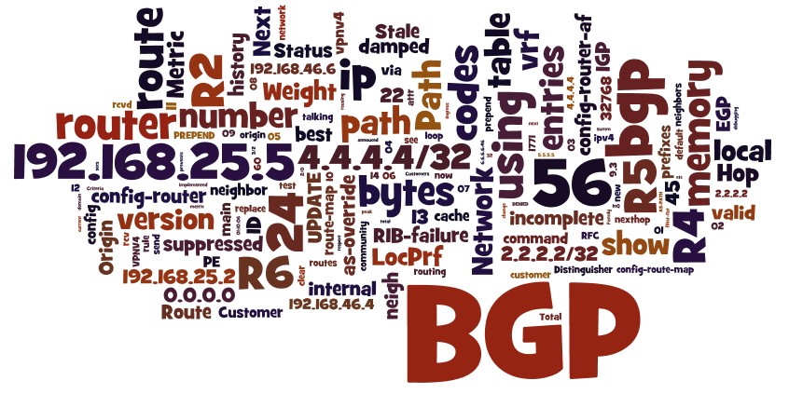
Customize your bgpaas
bgpaas_2:
type: OS::ContrailV2::BgpAsAService
properties:
name: 'bgp-session-1'
virtual_machine_interface_refs: [{ get_resource: vmi_2 }]
autonomous_system: '65511'
bgpaas_session_attributes:
{
bgpaas_session_attributes_address_families:
{
bgpaas_session_attributes_address_families_family: ['inet','inet6'],
},
bgpaas_session_attributes_family_attributes:
[{
bgpaas_session_attributes_family_attributes_address_family: inet,
bgpaas_session_attributes_family_attributes_loop_count: 1,
bgpaas_session_attributes_family_attributes_prefix_limit:
{
bgpaas_session_attributes_family_attributes_prefix_limit_maximum: 10
}
}]
bgpaas_session_attributes_as_override: 'true'
bgpaas_session_attributes_hold_time: '30'
bgpaas_session_attributes_private_as_action: 'remove'
}

Slide 57



Neutron vs contrail ?
Neutron objects are available
We can use them with Contrail
Not all Contrail objects are compatible with Contrail

Slide 58


When do we have to change?
You need additional features that only Contrail can offer
For example, ECMP fields
You need to implement something that, conceptually, is totally different between Contrail and vanilla Neutron
For example, VN that need to go outside the DC

Slide 59

Lost in translation
We start from a Neutron based template
And need to move to a Contrail based one
We tried to identify some common use-cases
And give best practices on how to transform a stack of Neutron objects in one made with Contrail objects

Slide 60


Creating services is like a puzzle!

Slide 61
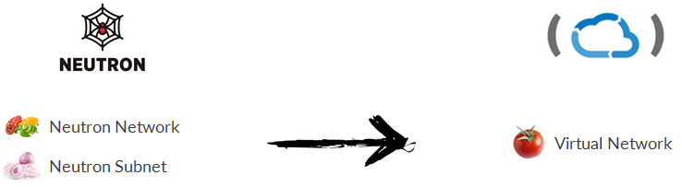
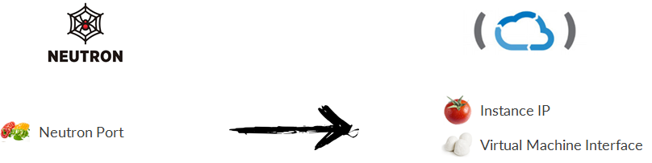
Basic translation

Slide 62
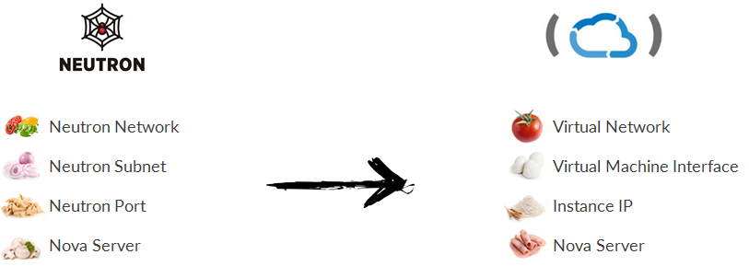
Translation #1
Create a VM with one vNIC connected to a new virtual network

Slide 63

Heat map #1
vmi
virtual network
vm
instance ip

Slide 64
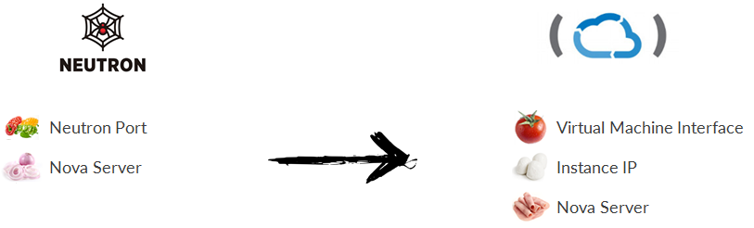
Translation #2
Create a VM with one vNIC connected to an existing virtual network

Slide 65

Heat map #2
vmi
virtual network
vm
instance ip

Slide 66
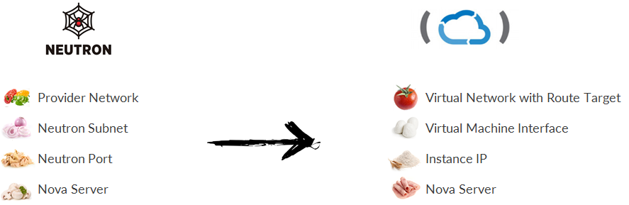
Translation #3
Create a VM with one vNIC connected to a new virtual network that needs to go outside the DC

Slide 67
Heat map #3
vmi
virtual network
vm
matching Route Target
instance ip
VRF on SDN gateway

Slide 68
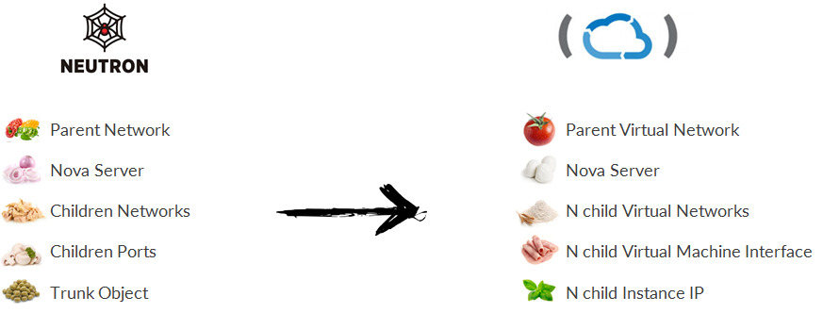
Translation #4
The VM vNIC needs to be configured as trunk with N vlans

Slide 69
Heat map #5
instance IP 1
child vmi 1
child vn 1
parent vmi
vm
parent vn
child vmi N
child vn N
instance IP N

Slide 70
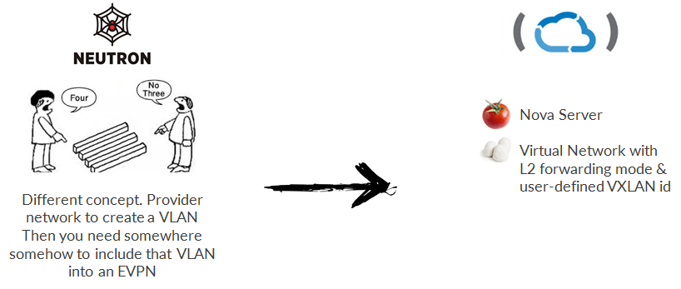
Translation #5
The VM needs to be connected to a L2 network, VXLAN ready

Slide 71
Heat map #5
vmi
virtual network (VXLAN)
vm
matching Route Target
instance ip
EVPN on SDN gateway

Slide 72
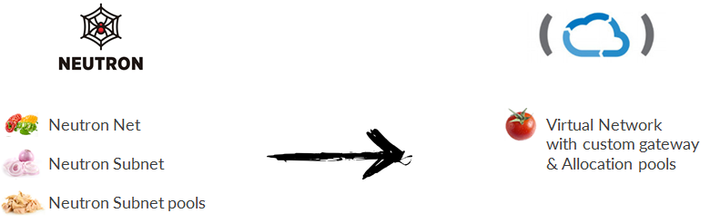
Translation #6
The virtual network needs to use a custom gw and a custom allocation pool

Slide 73
Heat map #6
vmi
virtual network
vm
gateway
subnet pool
instance ip

Slide 74
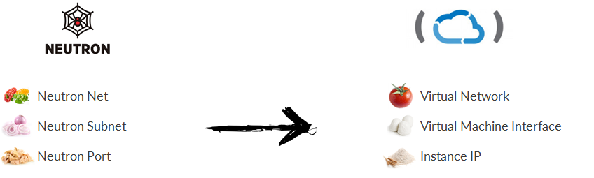
Translation #7
The VM must have a vNIC with a custom MAC, a fixed IP and must allow the configuration of a VIP address

Slide 75
Heat map #7
vmi
mac
aap
virtual network
vm
instance ip
fixed IP

Slide 76
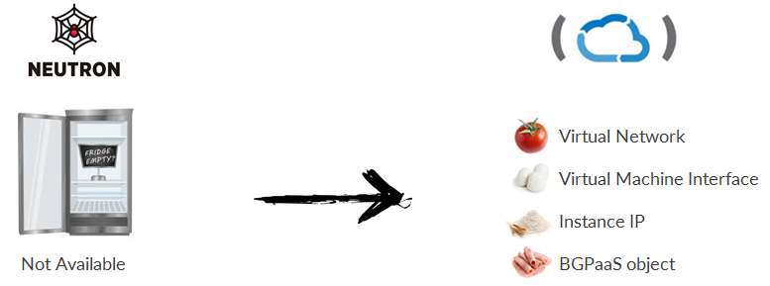
Translation #8
The VM must talk BGP in order to exchange BGP routers and use BFD for faster failure detection

Slide 77
Heat map #8
bgpaas
vmi
virtual network
vm
instance ip

Slide 78
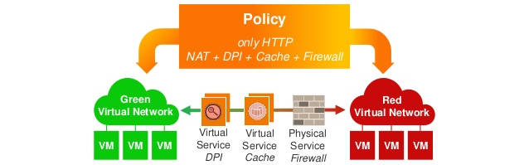
Service chaining
Contrail exclusive feature
Manage communications between virtual networks
By adding services between them!

Slide 79
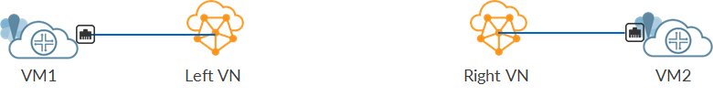
At first it was two networks
By default two virtual networks cannot talk to each other
They are separate broadcast domain
In a physical network we would need a router

Slide 80
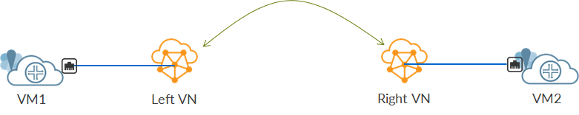
Then a policy connected them
Networks can talk to each other through a network policy
Applied to both virtual networks
A list of rules telling which traffic can pass or not
Rules built over protocol, dst/src addresses, dst/src virtual networks, dst/src ports

Slide 81
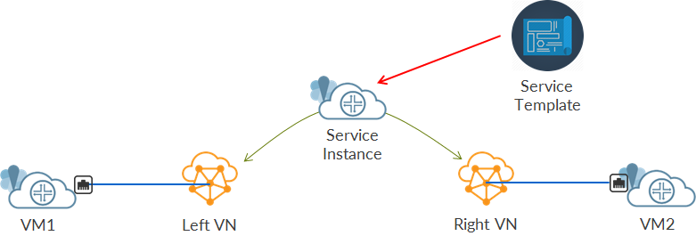
And a service controlled communications
If policy allows traffic to pass we can add one or more service between the two virtual networks
Service can be a firewall
We bring security between two virtual networks
Service chaining routing is automatically managed by Contrail

Slide 82

Service chain recipe
Two virtual networks
One network policy applied to those networks
One or more VMs acting as service elements
Service templates describing the nature of the service instance
Port tuple, a collection of ports belonging to a VM
Service instance, the actual service part of the service chain

Slide 83


Don’t be confused!
Based on the template
Uses ports of a VM as defined in a port tuple
A service instance is not a VM!
We might have multiple service instances using the same VM
service instance 1
NIC1
NIC2
NIC3
service template
NIC4
service instance 2

Slide 84

Service chain building blocks
Network policy
Service template
Service instance
Port tuple
Modified VMI
Service VM

Slide 85

Writing your policy
type: OS::ContrailV2::NetworkPolicy
properties:
name: { get_param: pol_name }
network_policy_entries: {
network_policy_entries_policy_rule: [{
network_policy_entries_policy_rule_direction: { get_param: direction },
network_policy_entries_policy_rule_protocol: { get_param: protocol },
network_policy_entries_policy_rule_src_ports: [{
network_policy_entries_policy_rule_src_ports_start_port: { get_param: src_port_start },
network_policy_entries_policy_rule_src_ports_end_port: { get_param: src_port_end }
}],
network_policy_entries_policy_rule_dst_ports: [{
network_policy_entries_policy_rule_dst_ports_start_port: { get_param: dst_port_start },
network_policy_entries_policy_rule_dst_ports_end_port: { get_param: dst_port_end }
}],
network_policy_entries_policy_rule_dst_addresses: [{
network_policy_entries_policy_rule_dst_addresses_virtual_network: { get_param: dst_add }
}],
network_policy_entries_policy_rule_src_addresses: [{
network_policy_entries_policy_rule_src_addresses_subnet: {
network_policy_entries_policy_rule_src_addresses_subnet_ip_prefix: {get_param: rule_cidr_1},
network_policy_entries_policy_rule_src_addresses_subnet_ip_prefix_len: {get_param: rule_mask_1},
}
}],
network_policy_entries_policy_rule_action_list: {
network_policy_entries_policy_rule_action_list_simple_action: { get_param: simple_action },
network_policy_entries_policy_rule_action_list_apply_service: [{ get_param: svc_inst_fq_name }]
},
}]
}

Slide 86
Applying policy to a virtual network
Policy must be assigned to virtual networks too
To both virtual networks, left and right
left_vn:
type: OS::ContrailV2::VirtualNetwork
depends_on: [ net_policy_apn_1 ]
properties:
...
network_policy_refs: [{ get_param: pol_fq_name }]
network_policy_refs_data:
[{
network_policy_refs_data_sequence:
{
network_policy_refs_data_sequence_major: 0,
network_policy_refs_data_sequence_minor: 0,
},
}]

Slide 87
Draw your template
Defines service characteristics
Type, mode, interfaces
svc_tmplt:
type: OS::ContrailV2::ServiceTemplate
properties:
name: { get_param: service_template_name }
service_template_properties:
{
service_template_properties_version: '2',
service_template_properties_service_mode: 'in-network',
service_template_properties_service_type: 'firewall',
service_template_properties_interface_type:
[
{
service_template_properties_interface_type_service_interface_type: 'left',
},
{
service_template_properties_interface_type_service_interface_type: 'right',
}
],
service_template_properties_ordered_interfaces: 'true',
}
domain: 'default-domain'

Slide 88


Define the service instance
We bind interfaces to virtual networks
svc_inst_apn_1:
type: OS::ContrailV2::ServiceInstance
depends_on: [ svc_tmplt ]
properties:
name: { get_param: svc_inst_name }
service_instance_properties:
{
service_instance_properties_interface_list:
[
{
service_instance_properties_interface_list_virtual_network:
{
list_join: [':', { get_attr: [ left_vn, fq_name ] } ]
},
},
{
service_instance_properties_interface_list_virtual_network:
{
list_join: [':', { get_attr: [ right_vn, fq_name ] } ]
},
}
],
}
service_template_refs: [{ get_resource: svc_tmplt }]

Slide 89
Gather ports into a tuple
Binds a list of interfaces
References a service instance
prt_tpl_1:
type: OS::ContrailV2::PortTuple
depends_on: [ svc_inst_apn_1 ]
properties:
name: { get_param: tuple_name }
service_instance: { list_join: [':', { get_attr: [ svc_inst_apn_1, fq_name ] } ] }
vmi_2:
type: OS::ContrailV2::VirtualMachineInterface
depends_on: [ prt_tpl_1 ]
properties:
virtual_machine_interface_properties:
{
virtual_machine_interface_properties_service_interface_type: 'left',
}
port_tuple_refs: [{ get_resource: prt_tpl_1 }]
virtual_network_refs: [{ list_join: [':', { get_attr: [ left_vn, fq_name ] } ] }]

Slide 90


Service vm will manage traffic
Standard VM
Some of its ports assigned to the service instance
VM
instance
vm1:
type: OS::Nova::Server
depends_on: [ iip_1, iip_2, iip_3 ]
properties:
name: {get_param: vm1name }
image: { get_param: image }
flavor: { get_param: flavor }
networks:
- port: { get_resource: vmi_1 }
- port: { get_resource: vmi_2 }
- port: { get_resource: vmi_3 }
left
right

Slide 91
Service chaining heat map
VM
x3 vmi
x3 instance IP
left vn
port tuple
policy
service instance
right vn
service template

Slide 92
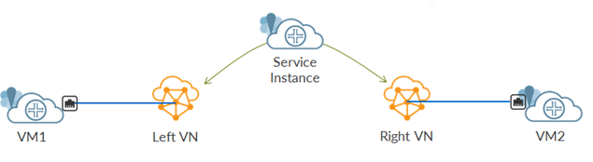
Use cases? Sky is the limit
Policy allows inter-VN communication
Service configured between the two VN
Service Firewall blocks some traffic!

Slide 93

Summing up
SDN brings automation
Automation in Openstack means Heat
Contrail has its own Heat objects
Models to create VNFs with Contrail
Best practices to translate Neutron templates to Contrail templates

Slide 94

That’s all!

